Slide 1

Financial Risk Analysis for Loan Default Prediction

Slide 2
Problem Statement >>>
This project aims to leverage Exploratory Data Analysis (EDA)and machine learning to conduct risk analysis for loan default prediction in the context of a consumer finance company. By analyzing historical loan application data, we will identify patterns and factors that indicate whether a client is likely to default on their loan payments. This analysis will assist the company in minimizing financial losses while ensuring that creditworthy applicants are not unfairly rejected.
The lending industry faces challenges in assessing creditworthiness, especially for applicants with limited credit history. Loan defaults pose financial risks to lending institutions. Our project aims to leverage Exploratory Data Analysis (EDA) and machine learning to predict loan default risk, assisting in minimizing financial losses.
In a simple way the objective is to leverage EDA and machine learning to predict loan default risk, aiding in minimizing financial losses and optimizing lending decisions.

Slide 3
Tools Used >>>
Programming Languages:-
Python for data analysis and modeling.
Jupyter Notebook or Google Colab for collaborative development.
Libraries:-
Pandas, NumPy, Matplotlib, Seaborn for data manipulation and visualization.
Scikit-learn for machine learning models [Decision Tree Classifier, Random Forest, and Extreme Gradient Boosting]..
Evaluation Metrics like Class precision, recall, F1-score, ROC-AUC score, and test set confusion matrix,etc.
Hyperparameter tuning using GridSearchCv.

Slide 4
Approaches >>>
Data Import and Exploration:
Imported necessary Python libraries for data manipulation and visualization.
Imported two datasets: application_data and previous_application.
Examined data dimensions:
application_data: (307511, 122)
previous_application: (1670214, 37)
Exploratory Data Analysis (EDA):
Identified factors associated with default and non-default applicants.
Notable insights:
Less likely to default: Female applicants, higher income, academic degrees, etc.
More likely to default: Male applicants, lower education level, lower income, etc.

Slide 5
Data Preprocessing:
Addressed several issues during preprocessing:
Missing values, skewed distributions, outliers, redundant features, and high dimensionality.
Handling missing values:-
Removed features with >40% missing values.
Employed missingness encoding for categorical features.
Filled continuous features with median and discrete features with mode.
Addressed skewed distributions and outliers using tree-based models.
Encoded categorical features using LabelEncoder.
Dropped redundant features and engineered new features from previous_application.
Reduced dataset dimensionality using feature importance scores from a random forest classifier.

Slide 6
Model Training and Evaluation:
Baseline model: Decision Tree classifier with max_depth = 3 and balanced class weights.
Other models tested: Balanced Random Forest Classifier and XGB Classifier.
Balanced Random Forest chosen to handle class imbalance.
Hyperparameter tuning for Balanced Random Forest via randomized grid search.
Evaluation metrics: Class precision, recall, F1-score, ROC-AUC score, and test set confusion matrix,etc.
Conclusion:
XGB Classifier emerged as the top performer, showing superior predictive accuracy and ability to distinguish between default and non-default cases.
Despite complexity and computational requirements, XGB Classifier offers the highest potential for accurate loan default prediction.
Decision Tree and Balanced Random Forest classifiers can still be viable options based on project requirements and computational resources.
XGB Classifier outperforms both Decision Tree and Balanced Random Forest classifiers in accuracy and ROC-AUC scores.

Slide 7
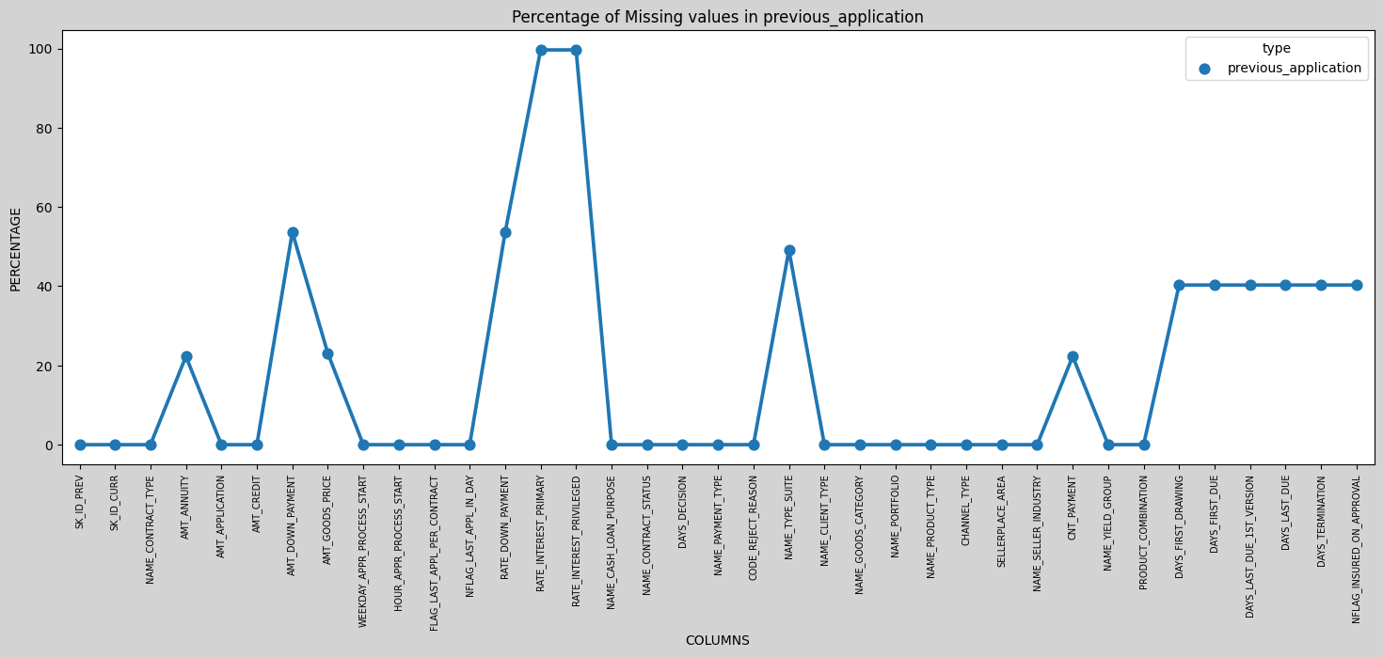
SOME EDA Insights >>>

Slide 8
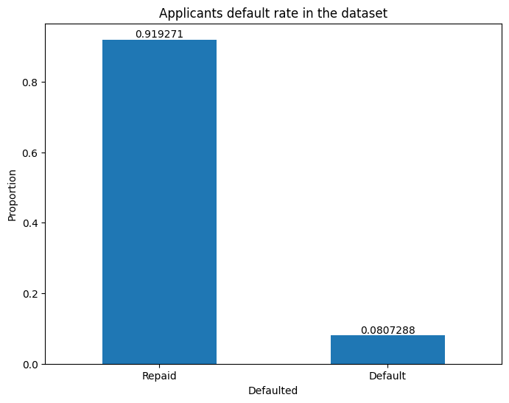
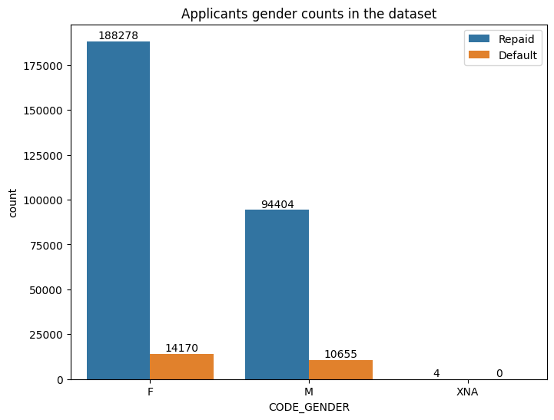

Slide 9
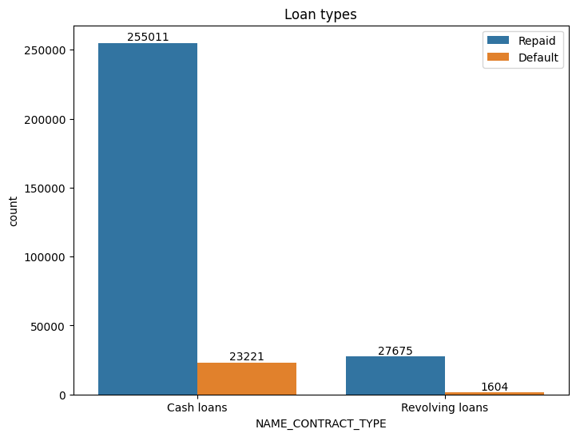
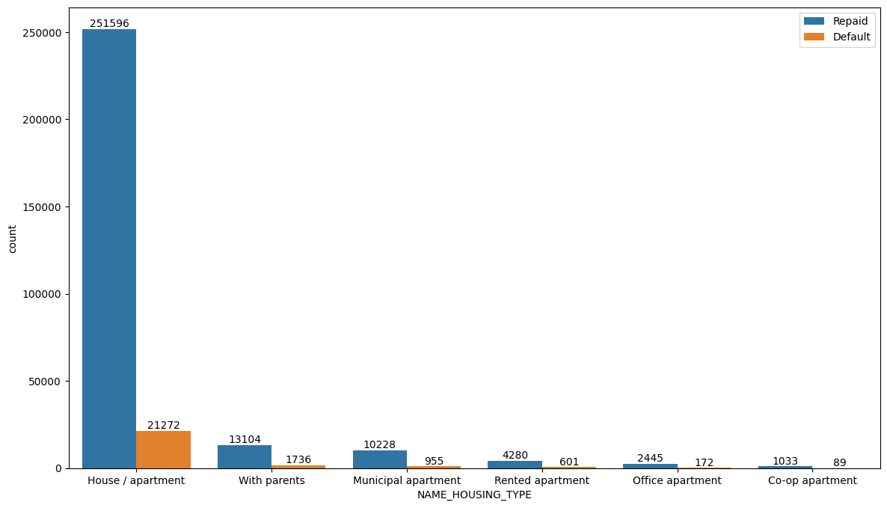

Slide 10
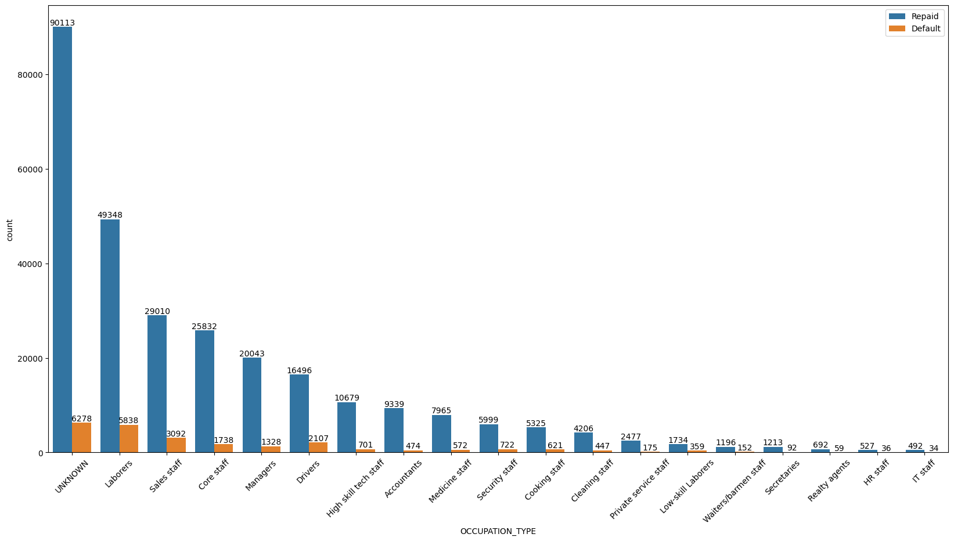
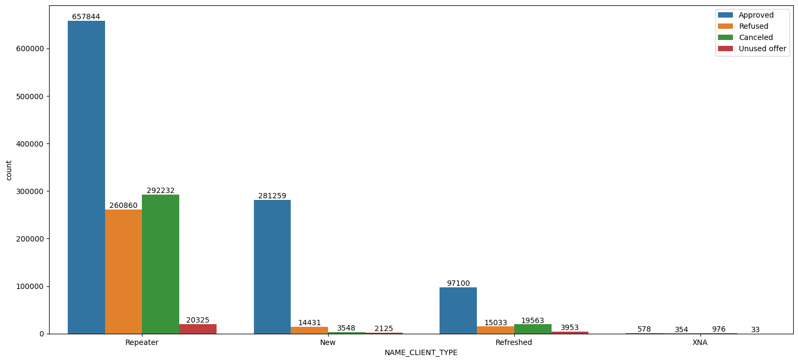

Slide 11
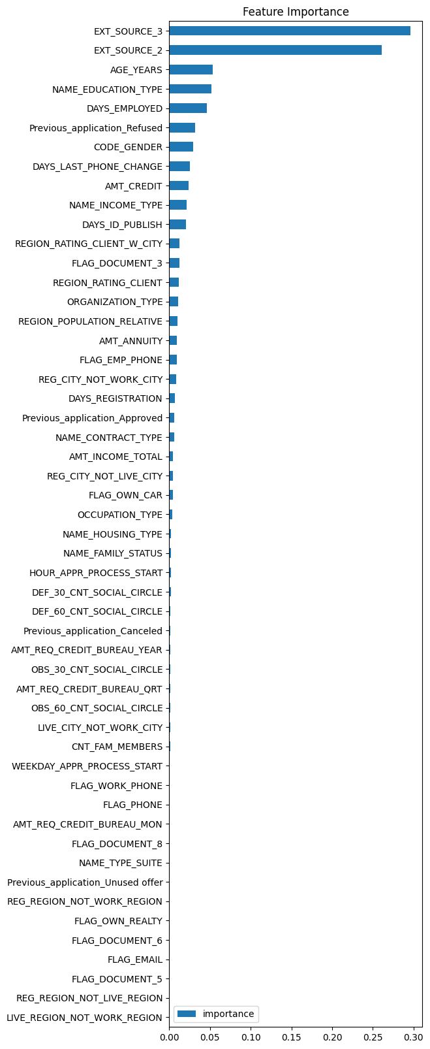

Slide 12


